Slide 1
User Manual
https://jinwei-task-manager.herokuapp.com/

Slide 2
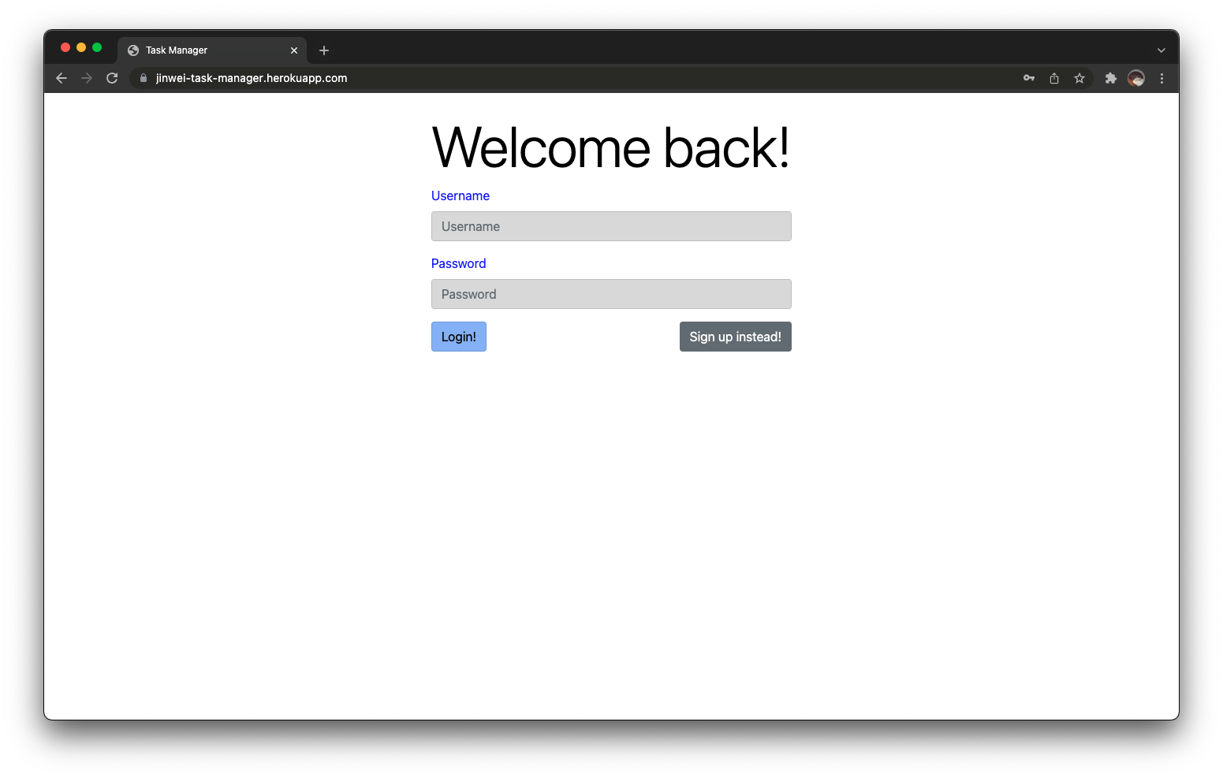
Login
Enter your username and password and press login.
Press on "Sign up instead!" to navigate to the signup page instead.

Slide 3
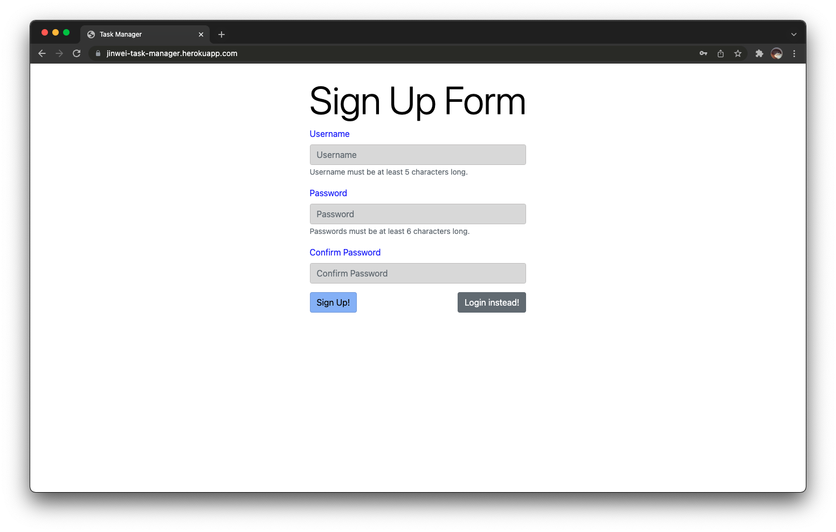
Sign Up
Enter your desired username and password twice and press login.
Press on "Login instead!" to navigate to the login page instead.

Slide 4
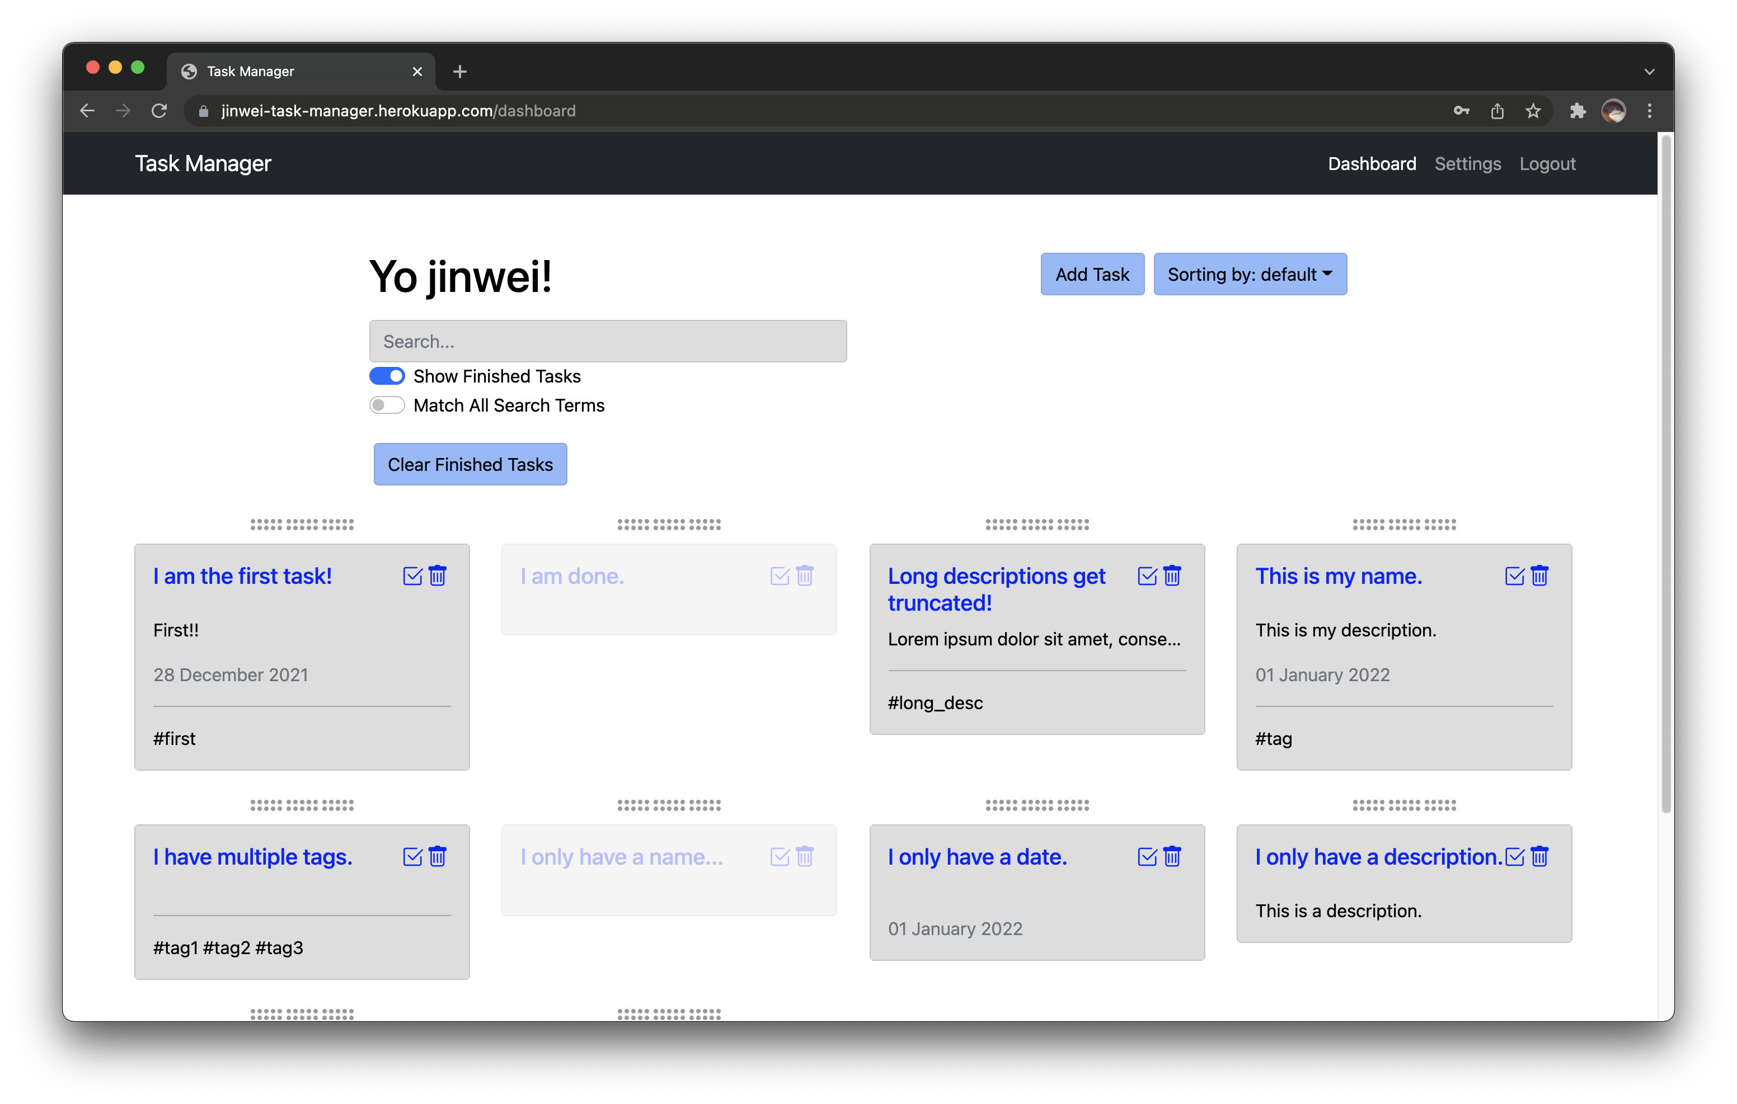
Dashboard
You will be re-directed here after successful login/signup.

Slide 5
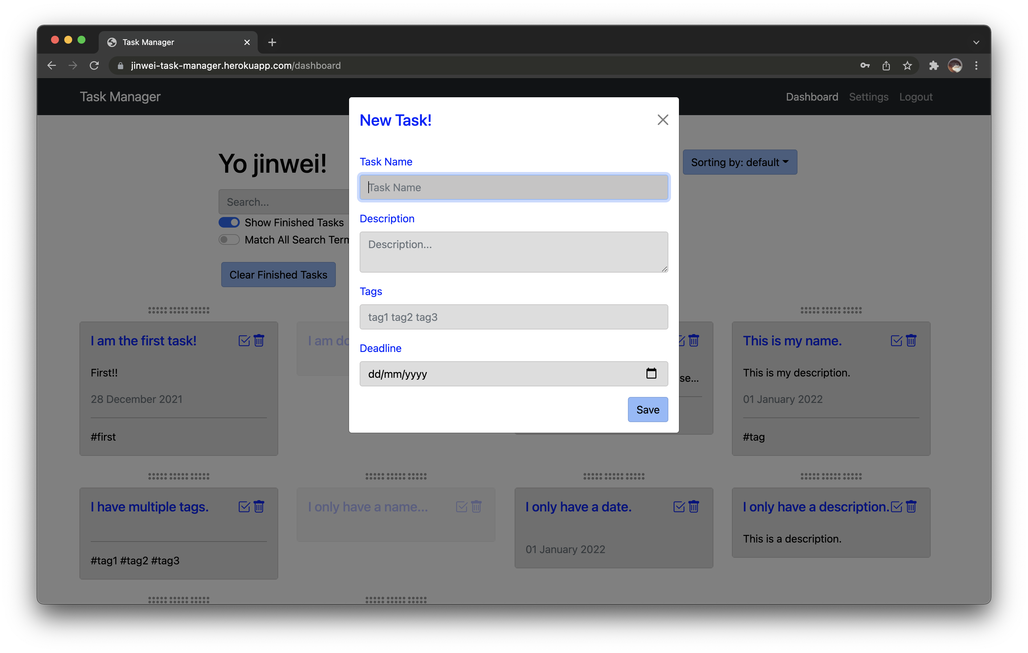
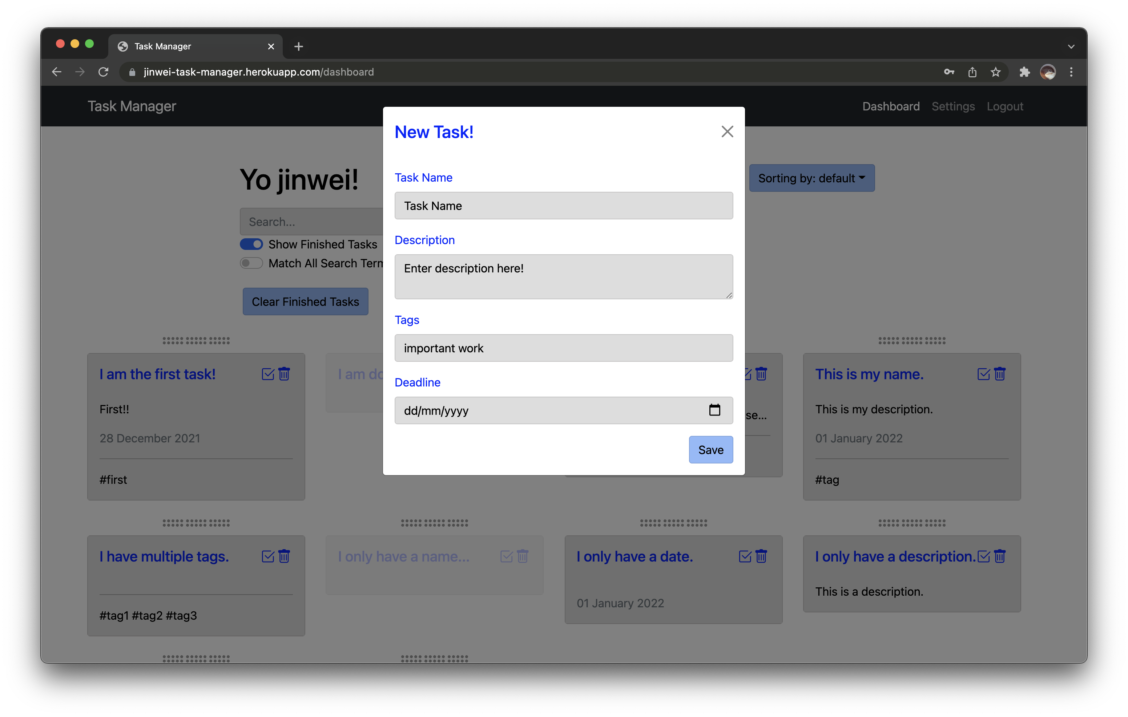
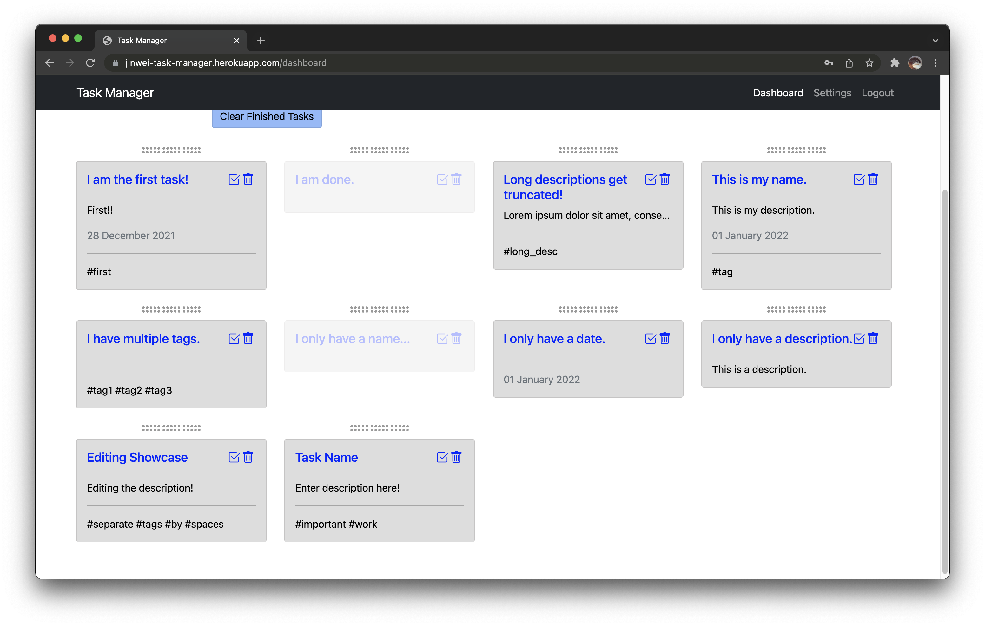
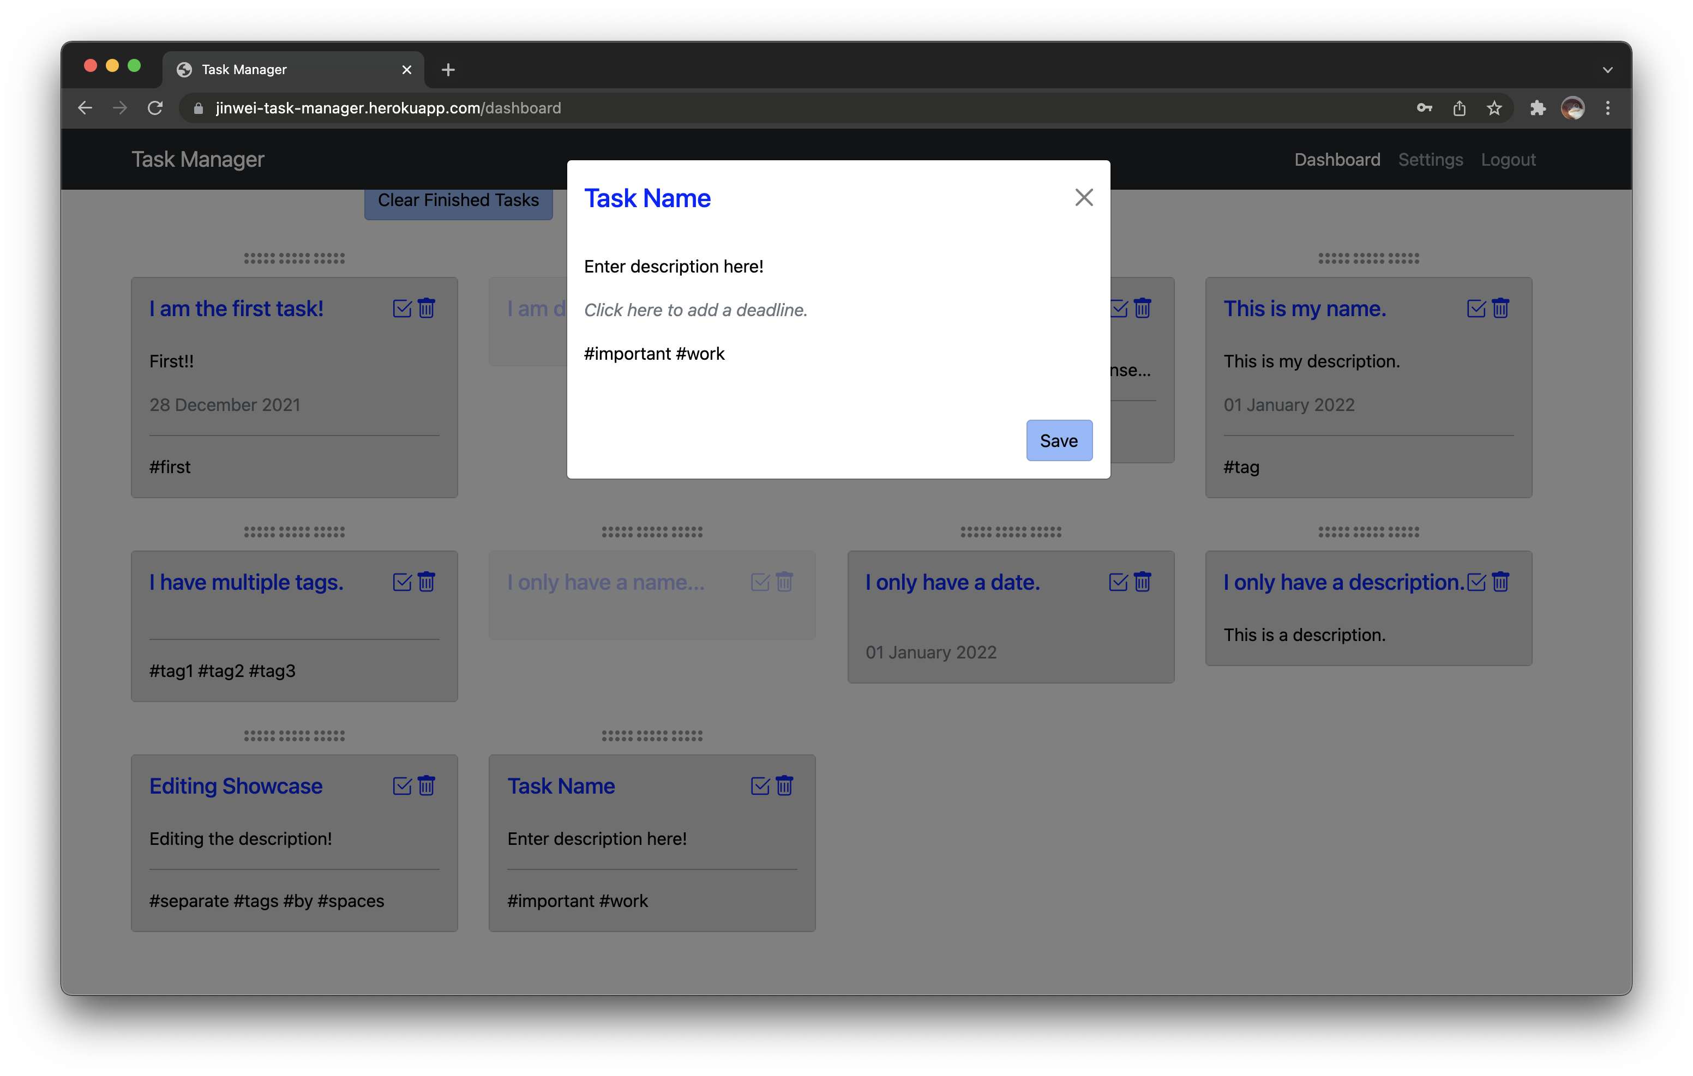
Adding a Task
Press the "Add Task" button to add a task. You will see the following window.
To save the task, fill up the form and press on "Save". The task will be added to the end.
To cancel, press on the cross on the top right. Note that this will not save the task.

Slide 6
Re-arranging Tasks
Tasks in "Default" sort can be re-arranged by dragging the dots above each task. Simply move it to the desired position and release your mouse or finger.

Slide 7
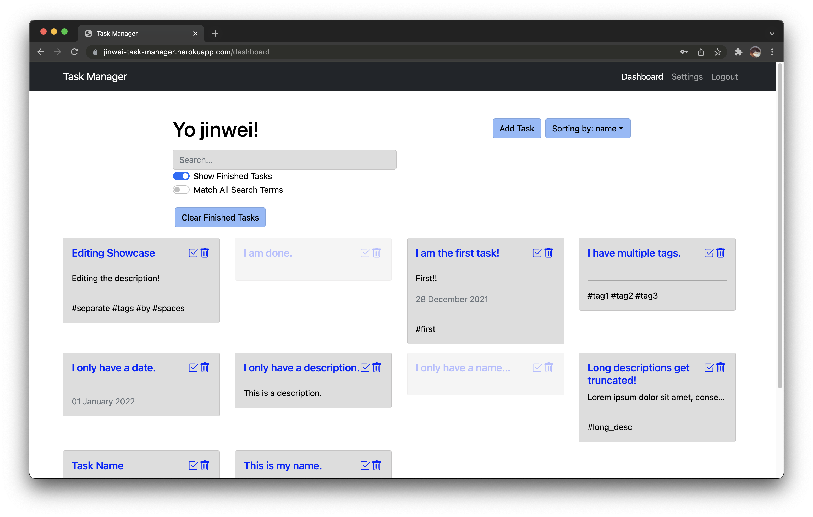
Sorting Tasks -- Name

Slide 8
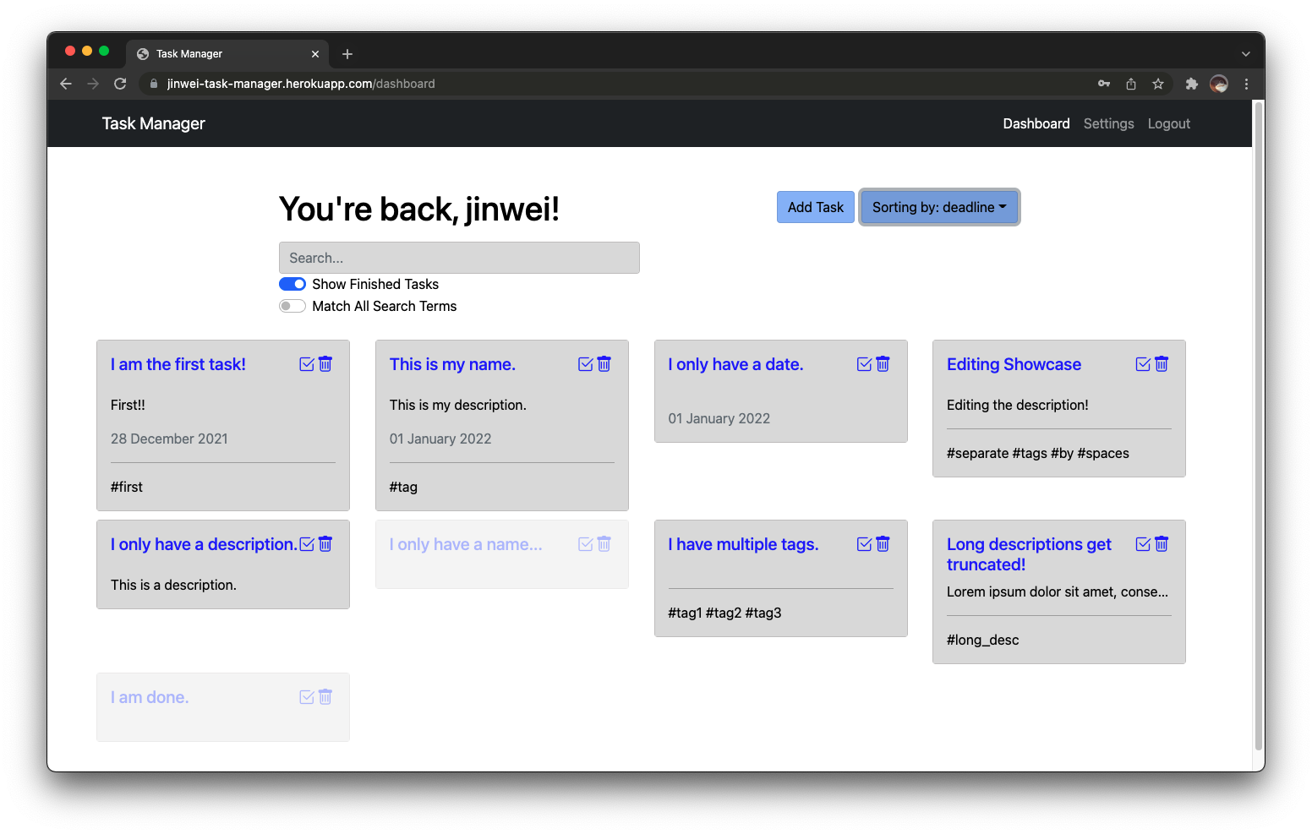
Sorting Tasks -- Deadline
The tasks without deadline will be at the back.

Slide 9
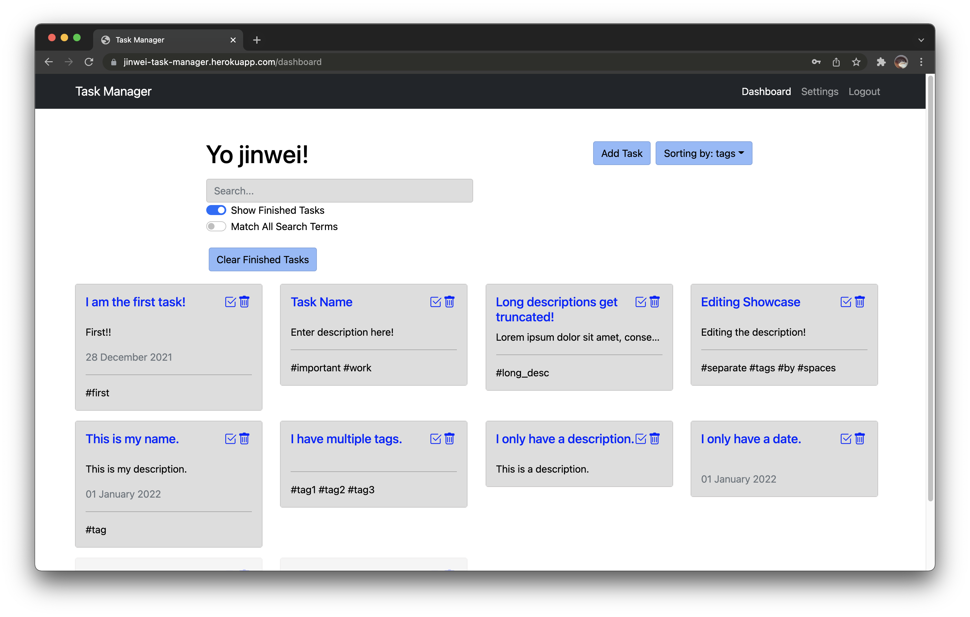
Sorting Tasks -- Tags
The tasks without tags will be at the back.

Slide 10
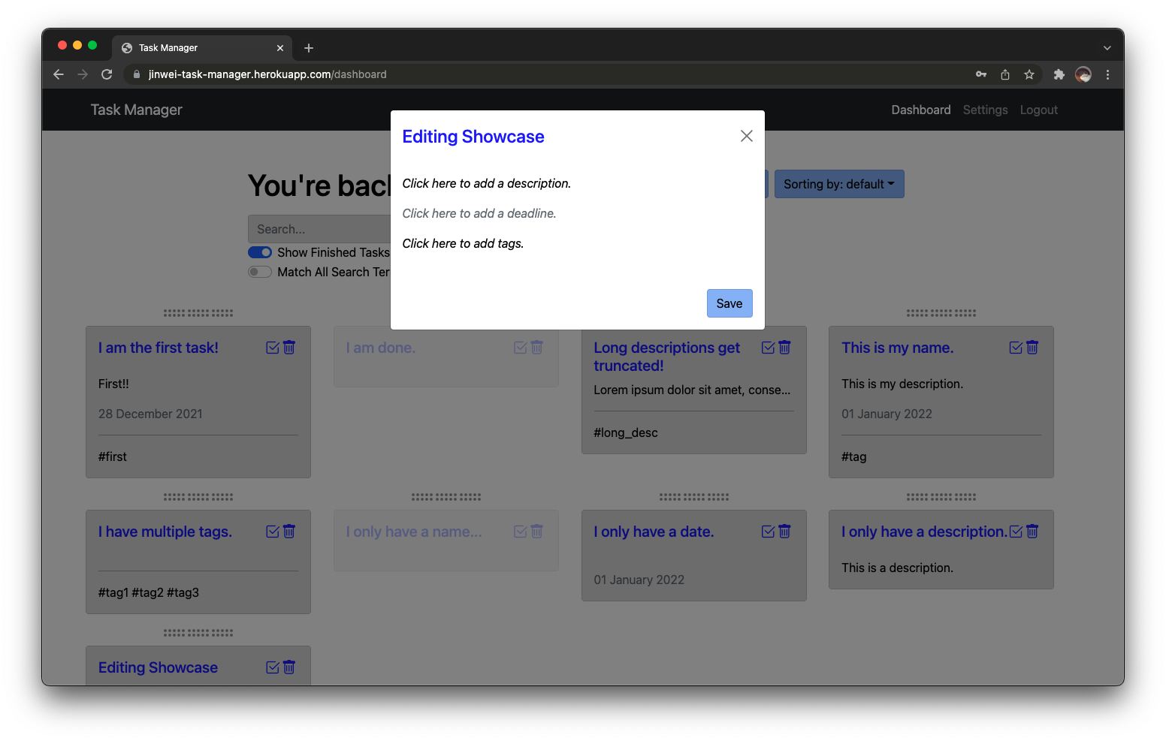

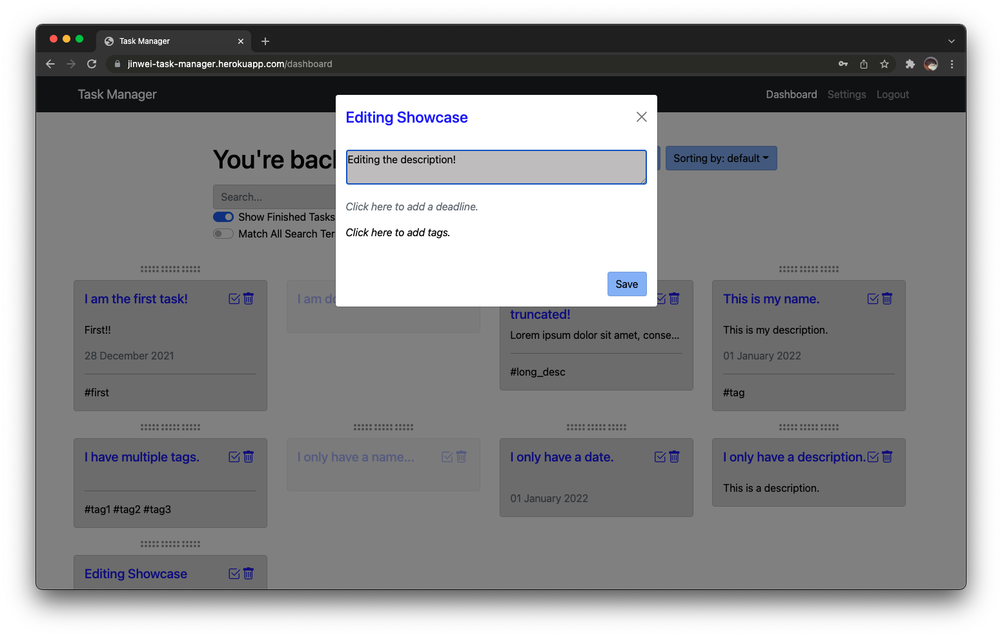
Editing Tasks
Click on the task name to bring up a focused view of the task. From here, you can edit the fields by simply clicking on the fields to be edited. For example, by clicking on the description.

Slide 11
Marking as Done and Deleting
Click on the checkmark and bin icons to mark as done and delete the task, respectively.

Slide 12
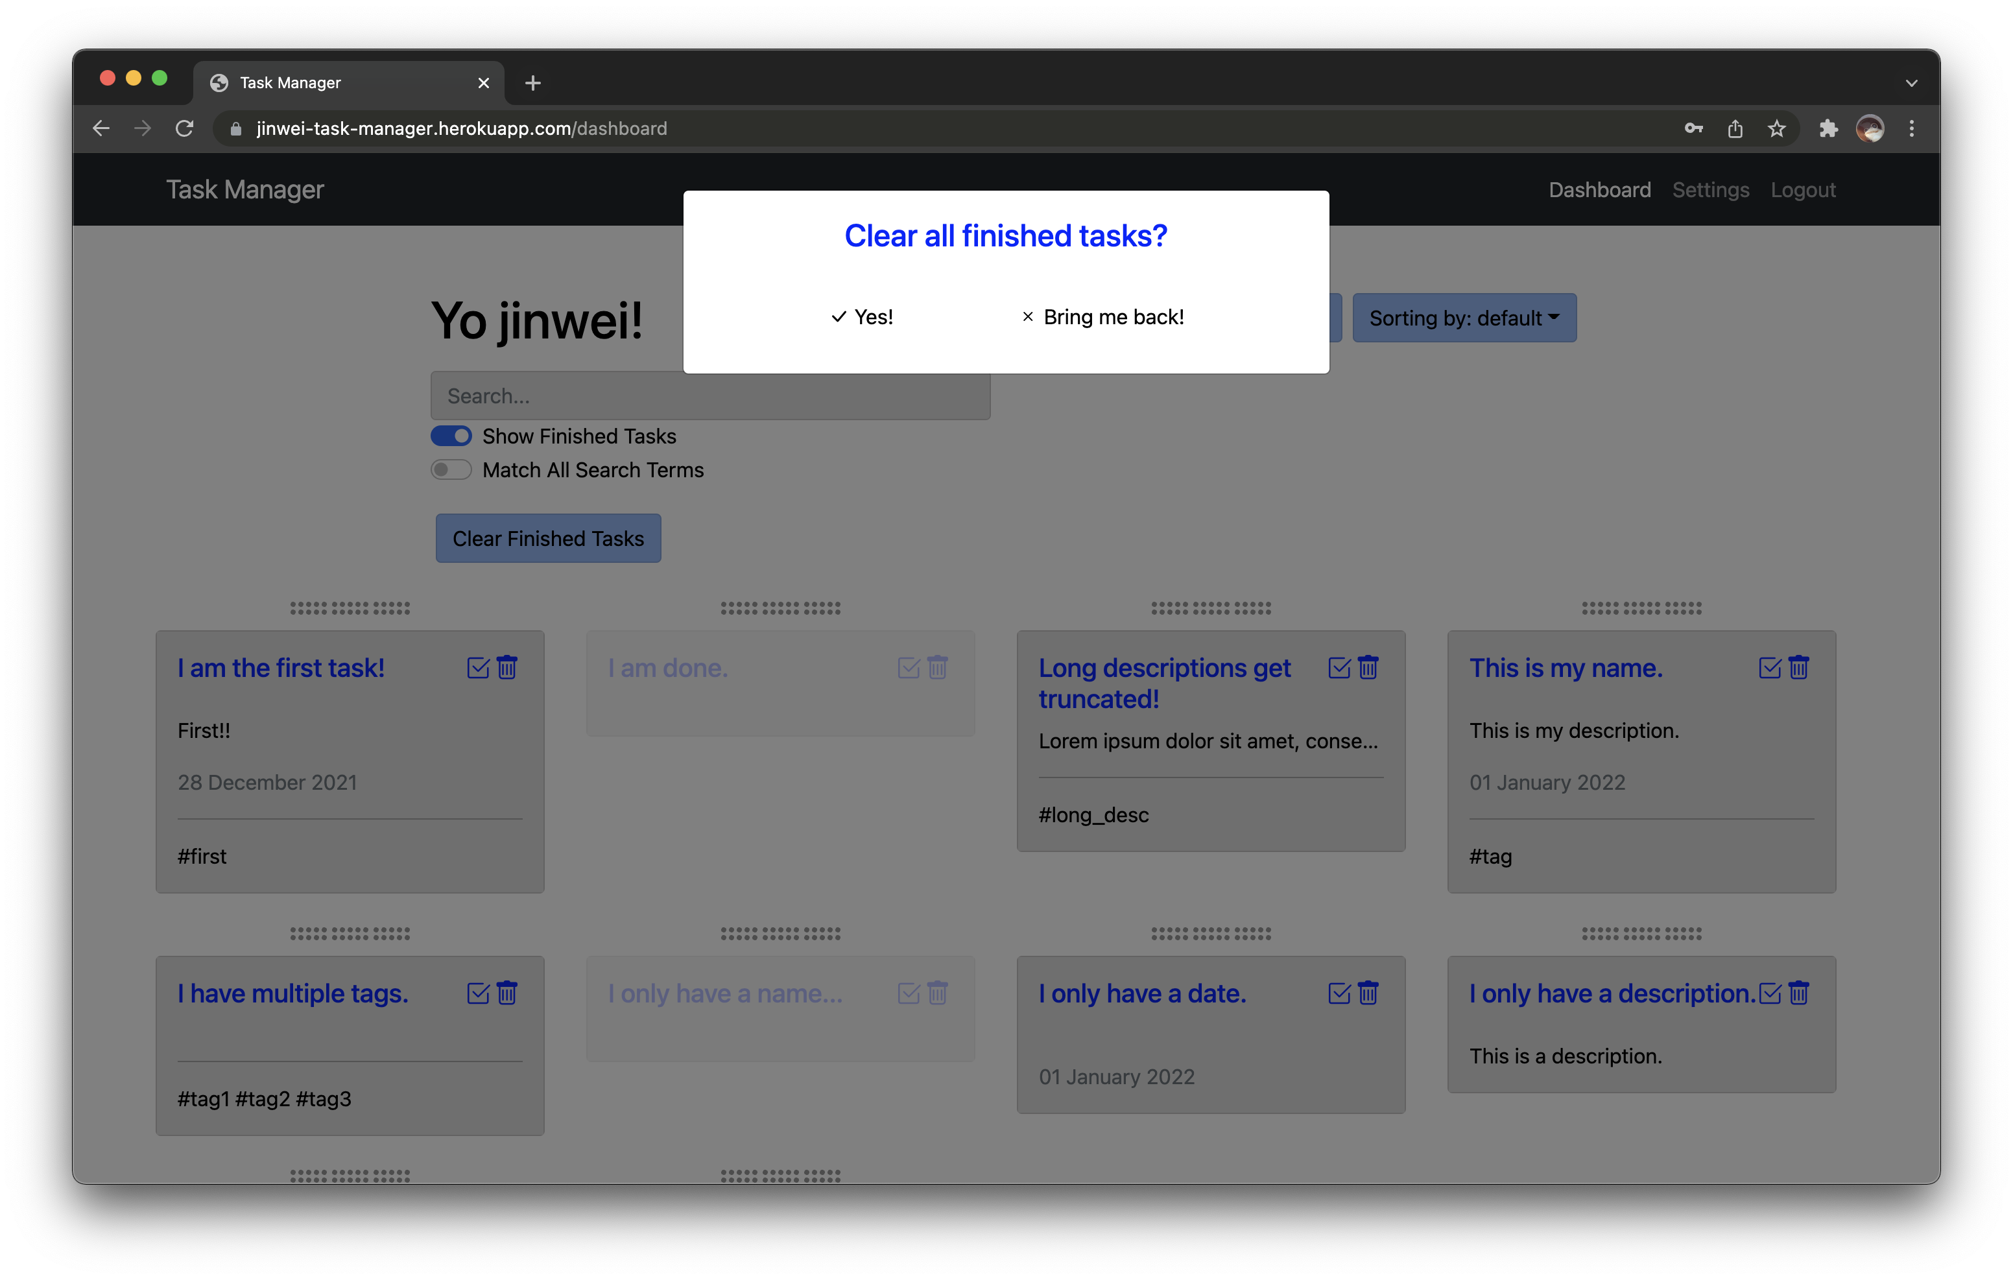
Clearing All Finished Tasks
Just press "Yes!" to confirm to clear all finished tasks. You can press anywhere else to exit as well.

Slide 13
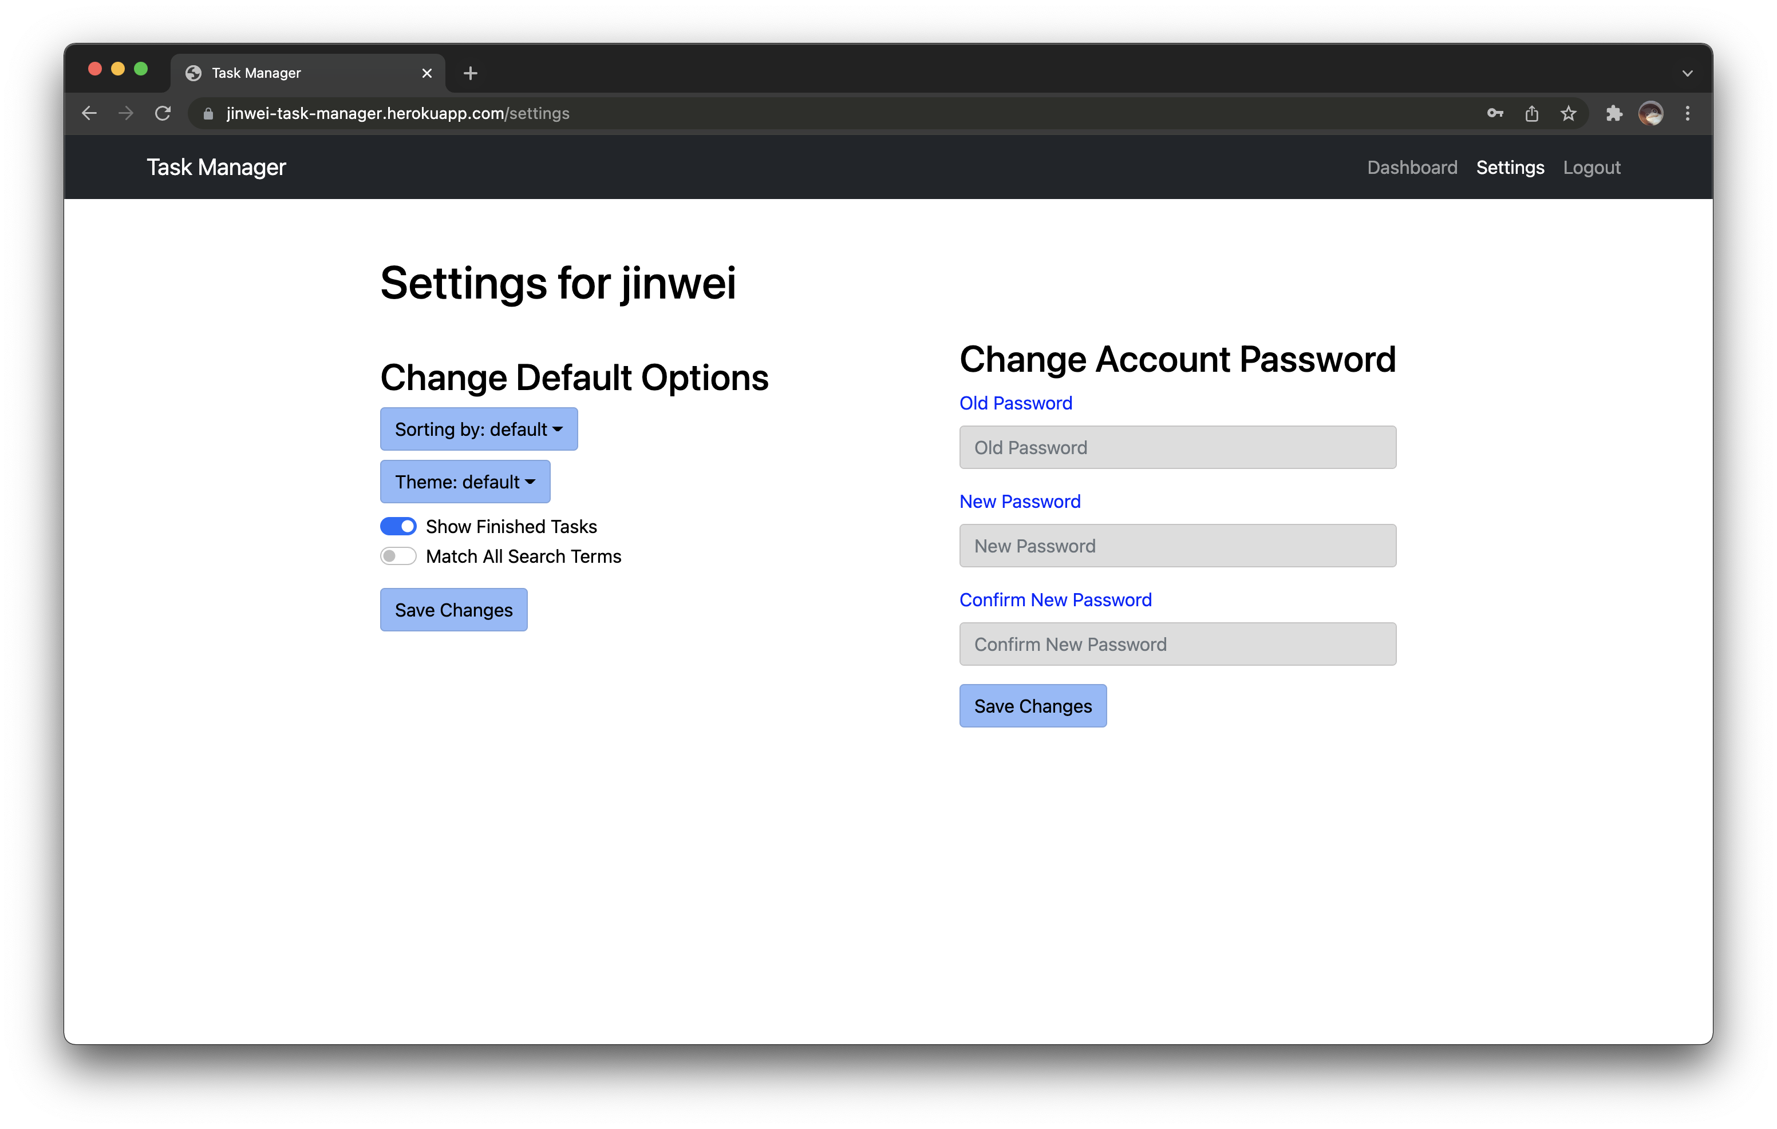
Settings
Here you can configure certain defaults.
You can change the default sort, default behaviour of showing finished tasks, default behaviour of matching all search terms. These 3 settings are tied to the user account.
You can also change the theme. This is stored as a cookie and is tied to the browser and not the user account.
You must press on "Save Changes" in order to save the changes made.
You can also change your account password.

Slide 14
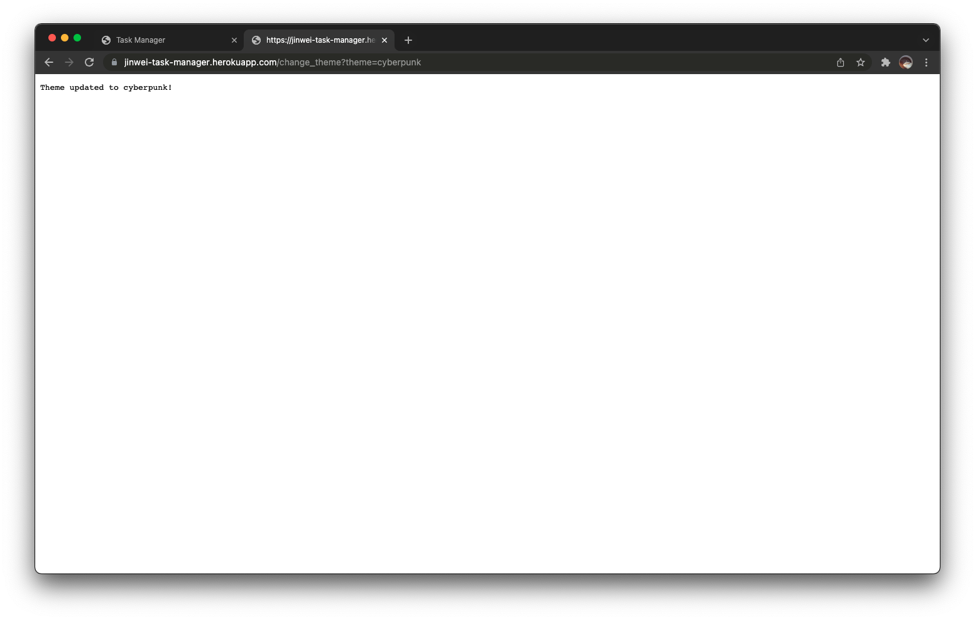
Themes
Currently, the available themes are "default", "dark" and "cyberpunk".
You can change your theme in the user settings.
You can change your theme without logging in by visiting this URL (replace default with the theme of your choice, case-sensitive): http://jinwei-task-manager.herokuapp.com/change_theme?theme=default or by changing the cookie in your browser labelled `theme`.

Slide 15
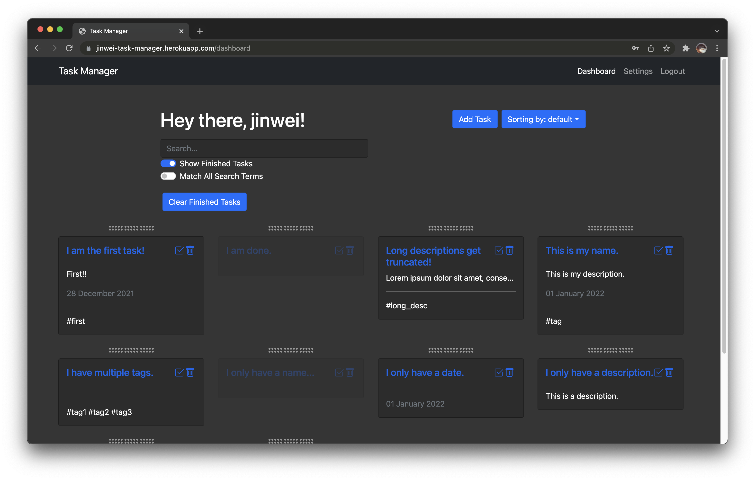
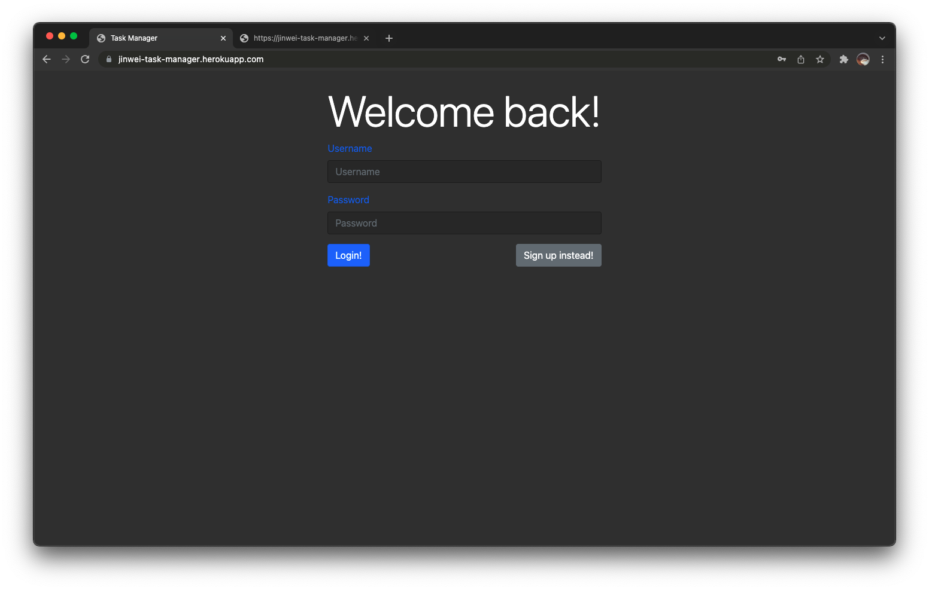
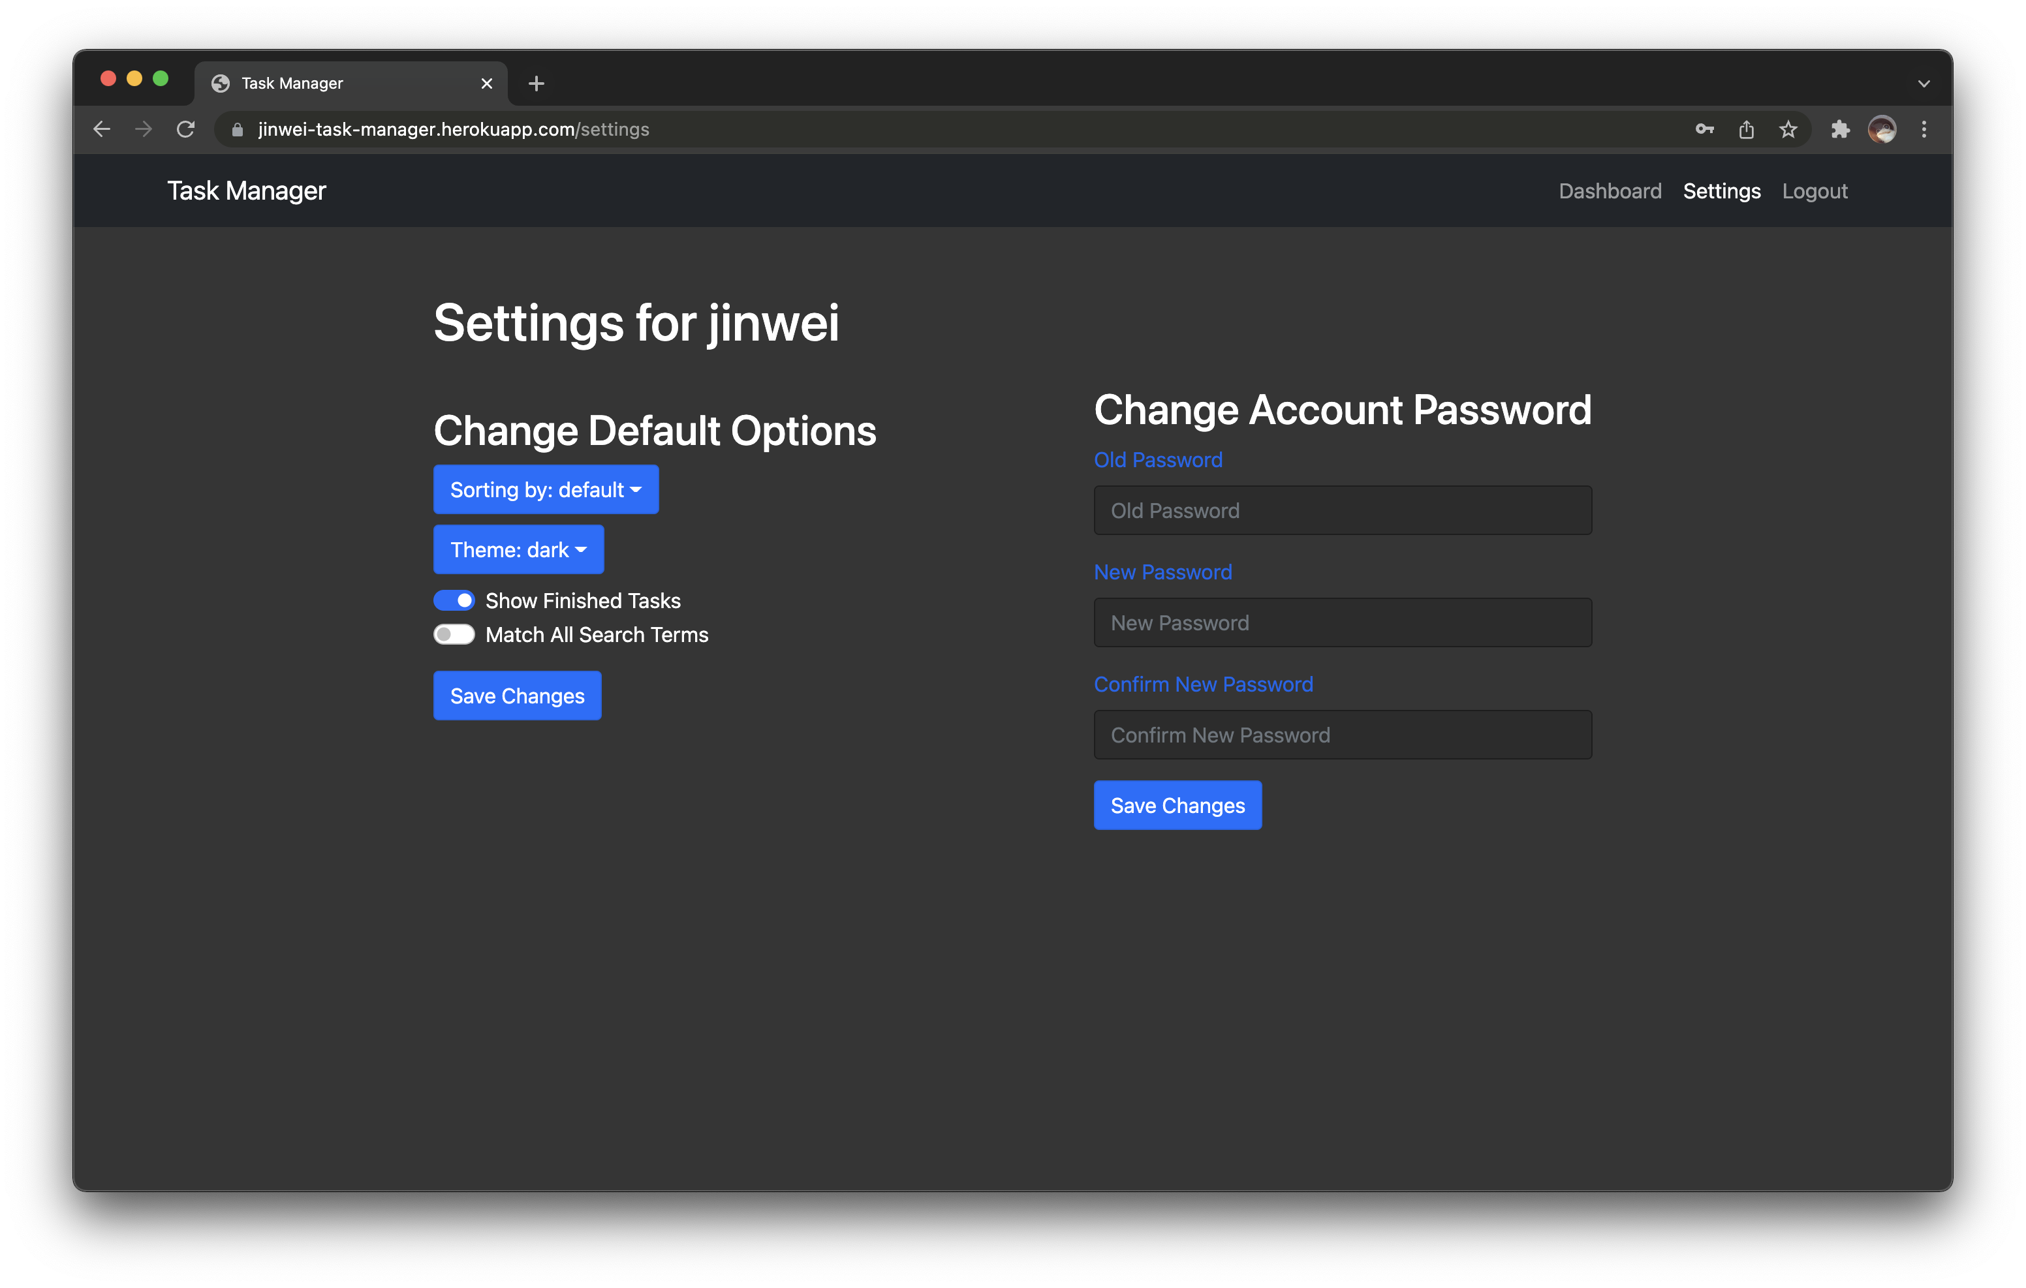
Dark Theme

Slide 16
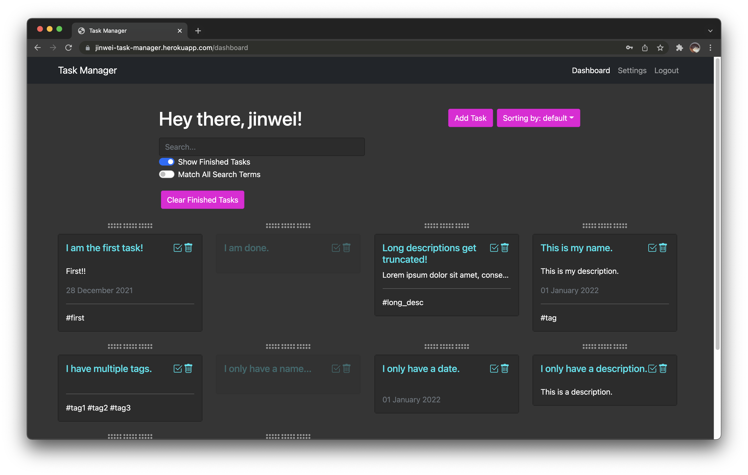
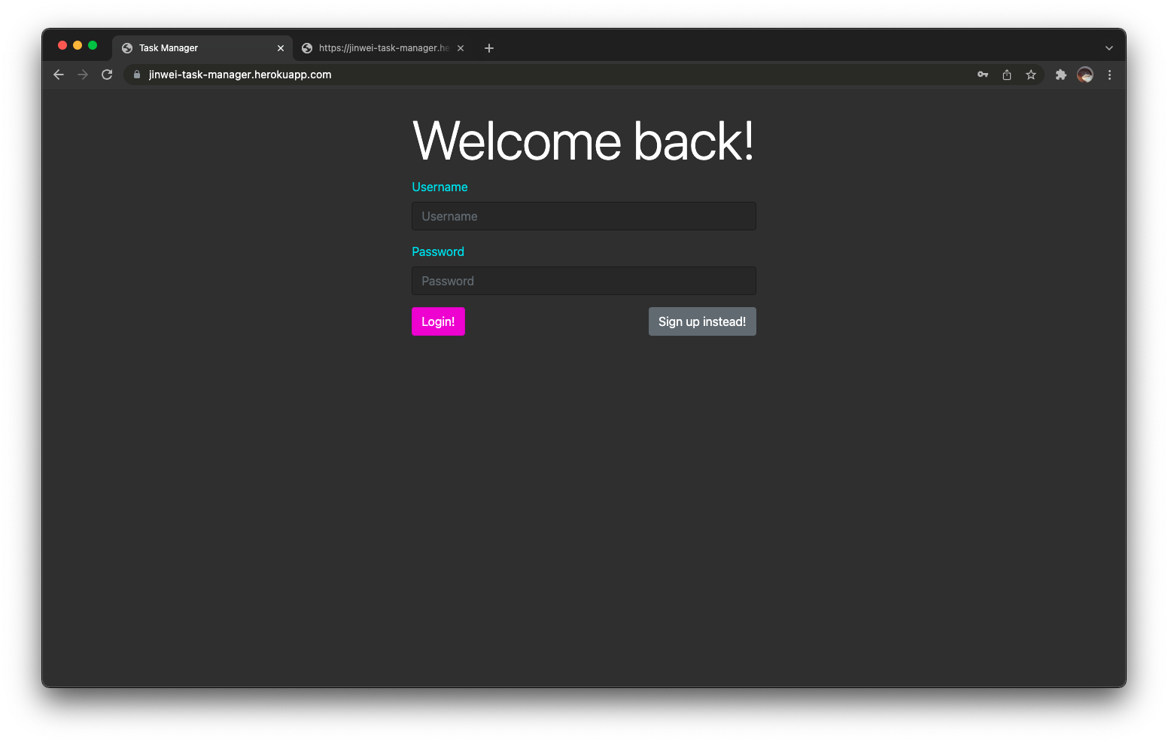
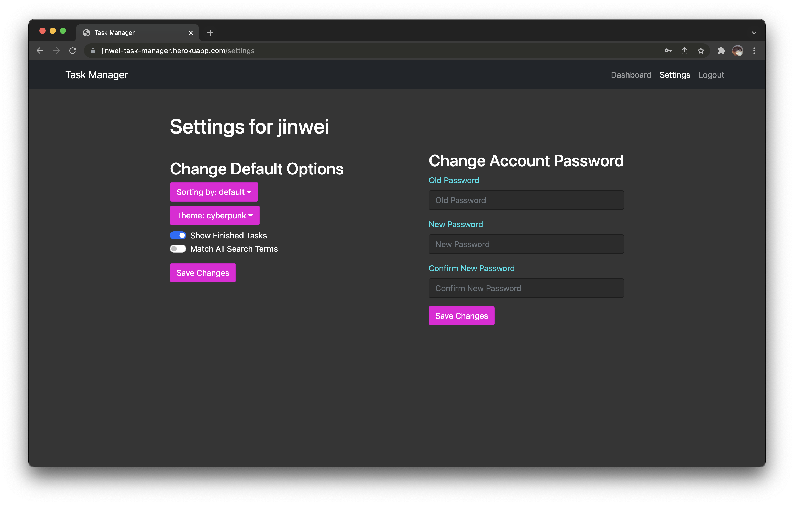
Cyberpunk Theme

